Slide 1
Analysis of NASA GPM Early 30-minute Run in Comparison to Walnut Gulch Experimental Watershed Rain Data
Adolfo Herrera
April 14 2018
Arizona Space Grant Symposium
Mentor: Eleonora Demaria

Slide 2
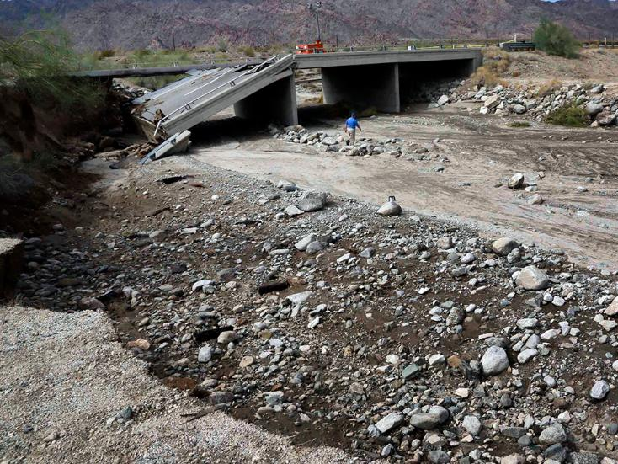
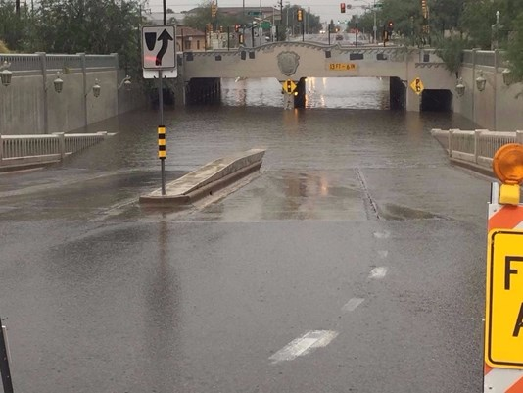
Background
Adequately estimating precipitation is important for water supply, ecosystem health, flood preparedness, and agriculture sustainability
Physical rain gauge networks are being decommissioned globally due to budget constraints

Slide 3
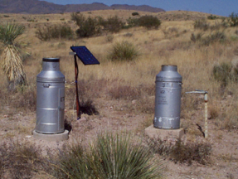
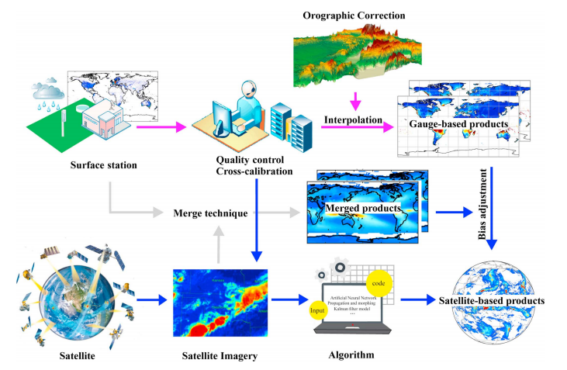
Comparison of Measurements
Satellite Estimate
Rain Gauge
Measures in swaths
Indirect estimate through cloud temperature
  Increases error
Resolution may vary but normally ~11km
Point measurement
Direct measurement that is very precise
Require quality control on individual devices to ensure accuracy
Source: Sun et al. A Review of Global Precipitation Data Sets

Slide 4
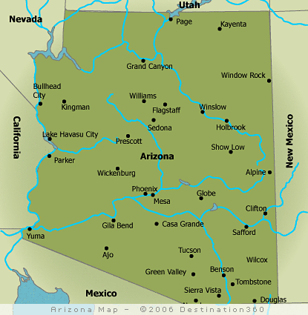
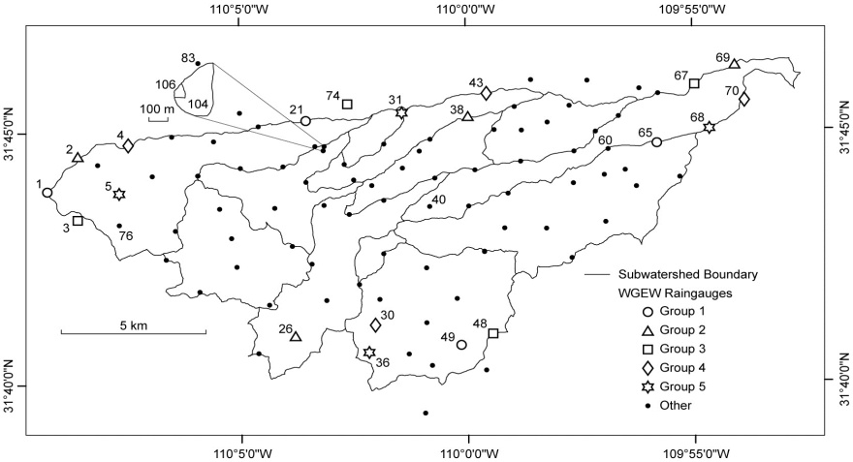
Goals/Data
Determine if NASA GPM IMERG estimates capture the spatial-temporal properties of precipitation in a semi-arid environment
Satellite data used:
  IMERG Early 30-minute run (resolution of 0.1°x0.1°)
Gauge data:
  ~1 rain gauge/0.5km²
Courtesy of Dave Goodrich
Source: destination360.com

Slide 5
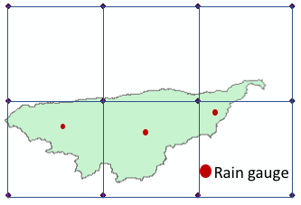
Methodology
The WGEW dataset is interpolated rain data throughout the watershed in 30 minute intervals
Root mean square error (RMSE), relative bias, and correlation coefficient used to analyze differences in datasets.
Prediction of detection (POD), false alarm rate (FAR), and critical success index (CSI) measures used to predict chance satellite correctly observes precipitation that the rain gauges observe

Slide 6
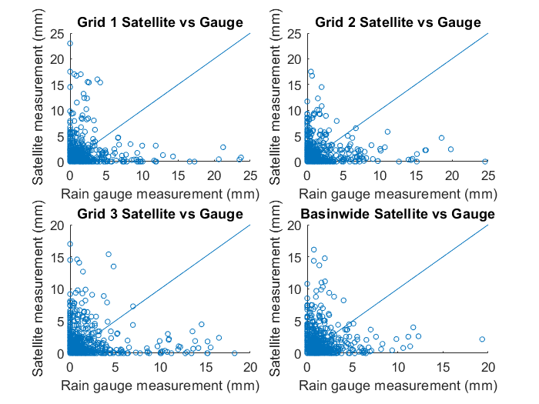
Scatterplots Show Sizable Spread in Points

Slide 7
Satellite Estimates Have Trouble Capturing Highly Variable and Intense Monsoon Storms
Notes:
Explain grid cells as they correspond to each bar; explain how basinwide is calculated; RMSE emphasizes difference in large values.
Basinwide: Satellite overestimates observations during the winter for both point and basinwide (magnitude of around 40%). Correlation coefficient is also larger in winter, possibly because of more uniform storms with lower intensity; the satellite may be better suited to capture these. During the summer monsoon season, the storms are more localized and have higher intensities; the satellite products may have much more trouble accurately estimating them.

Slide 8
GPM Estimates Struggle to Capture Monsoon Precipitation Events
Point by point
Basin-wide
Notes:
Not as much variability between the different grid cells for all three measures. Winter’s false alarm rate is lower

Slide 9
Conclusions
Results could be improved with time lag
The Early-run is not the only product. Late and Final runs are intended to be more accurate, but not necessarily real time
There is much more error in the monsoon season; this may be due to the unique characteristics of monsoon precipitation in this region
While many of the metrics from previously slides appear poor, this technology is trending in the correct direction

Slide 10
Acknowledgments
Thank you to Eleonora Demaria for guiding me on this project
Thank you to Carl Unkrich for providing the rain gauge data
Thank you to the USDA-ARS and NASA for helping fund this project

Slide 11
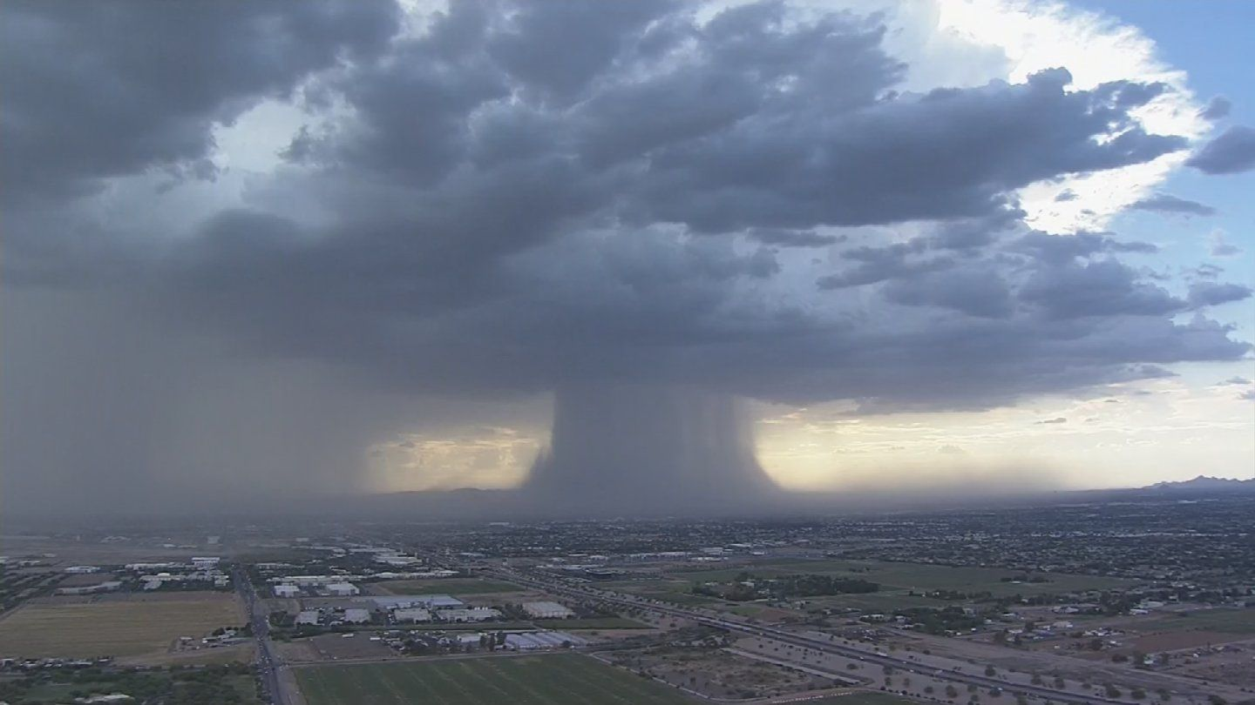
Thank you

